Slide 1
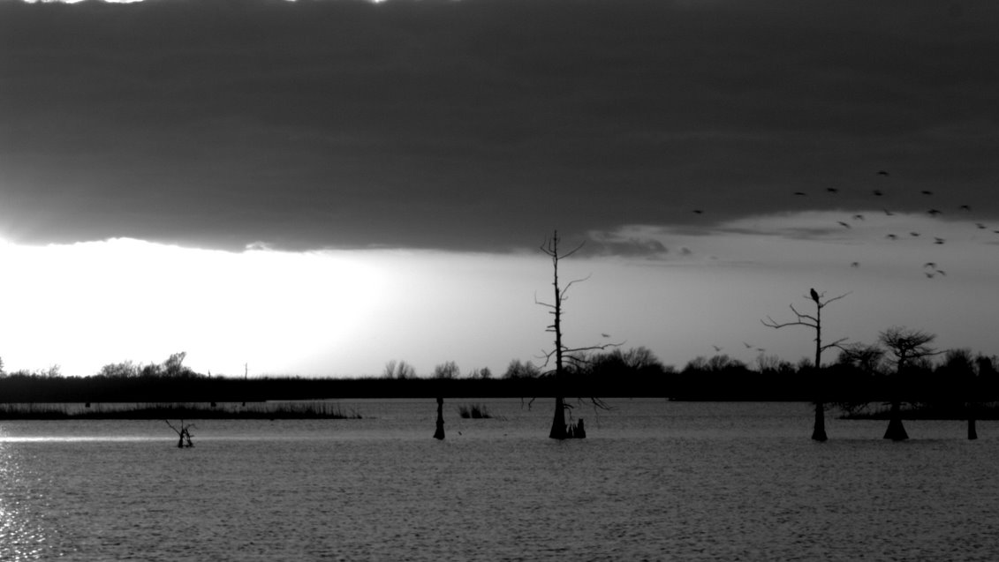
Common Air Pollutants
Code for Climate

Slide 2
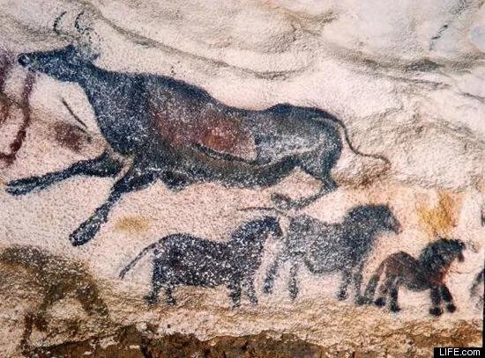
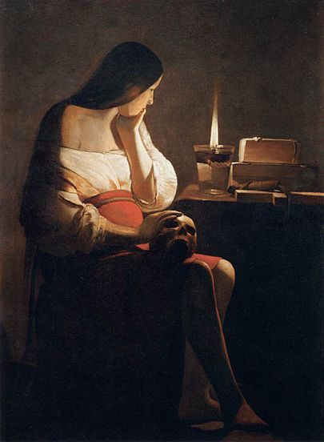
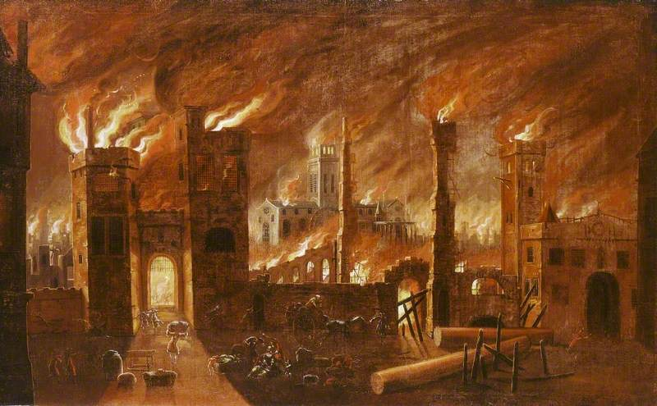
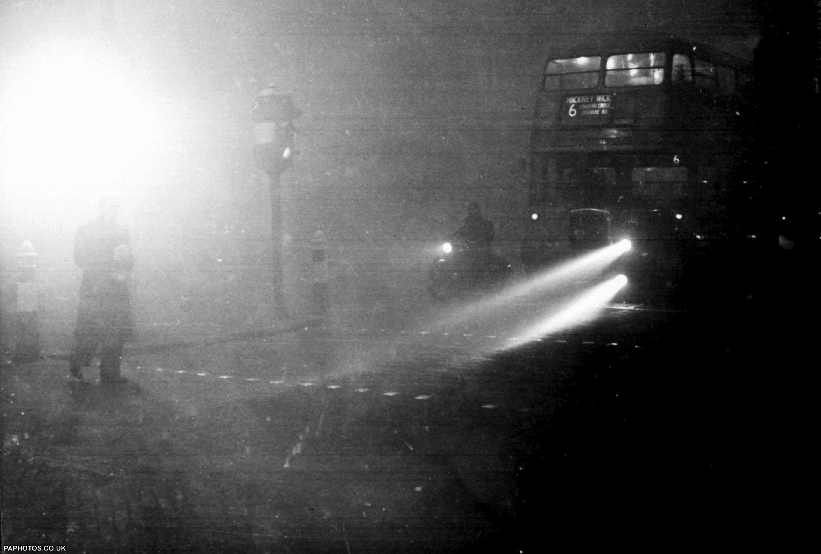
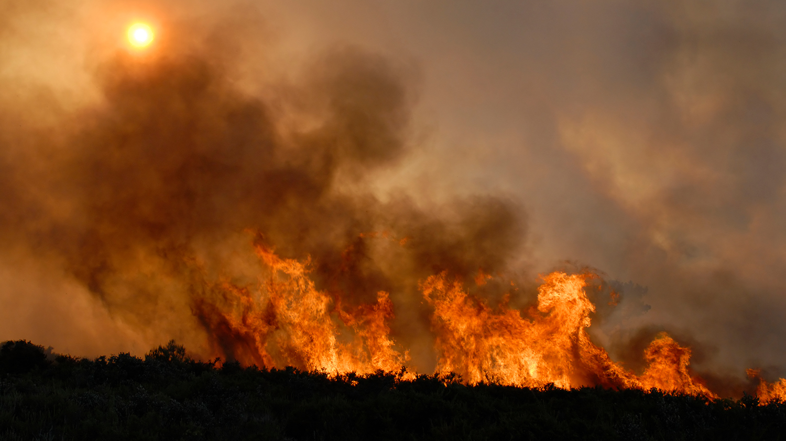
Can you see the common threads in these images?
Lascaux Cave Paintings, France
“Edge of Town” – Thomas Benton, 1938
“The Great Fire of London” – Jan Griffier, 1666
6 Dec 1952, London at 2 pm
“Magdalene with the Smoking Flame” – Georges de La Tour, 1640
“Factory Row” – James Turnbull, mid-1900

Slide 3
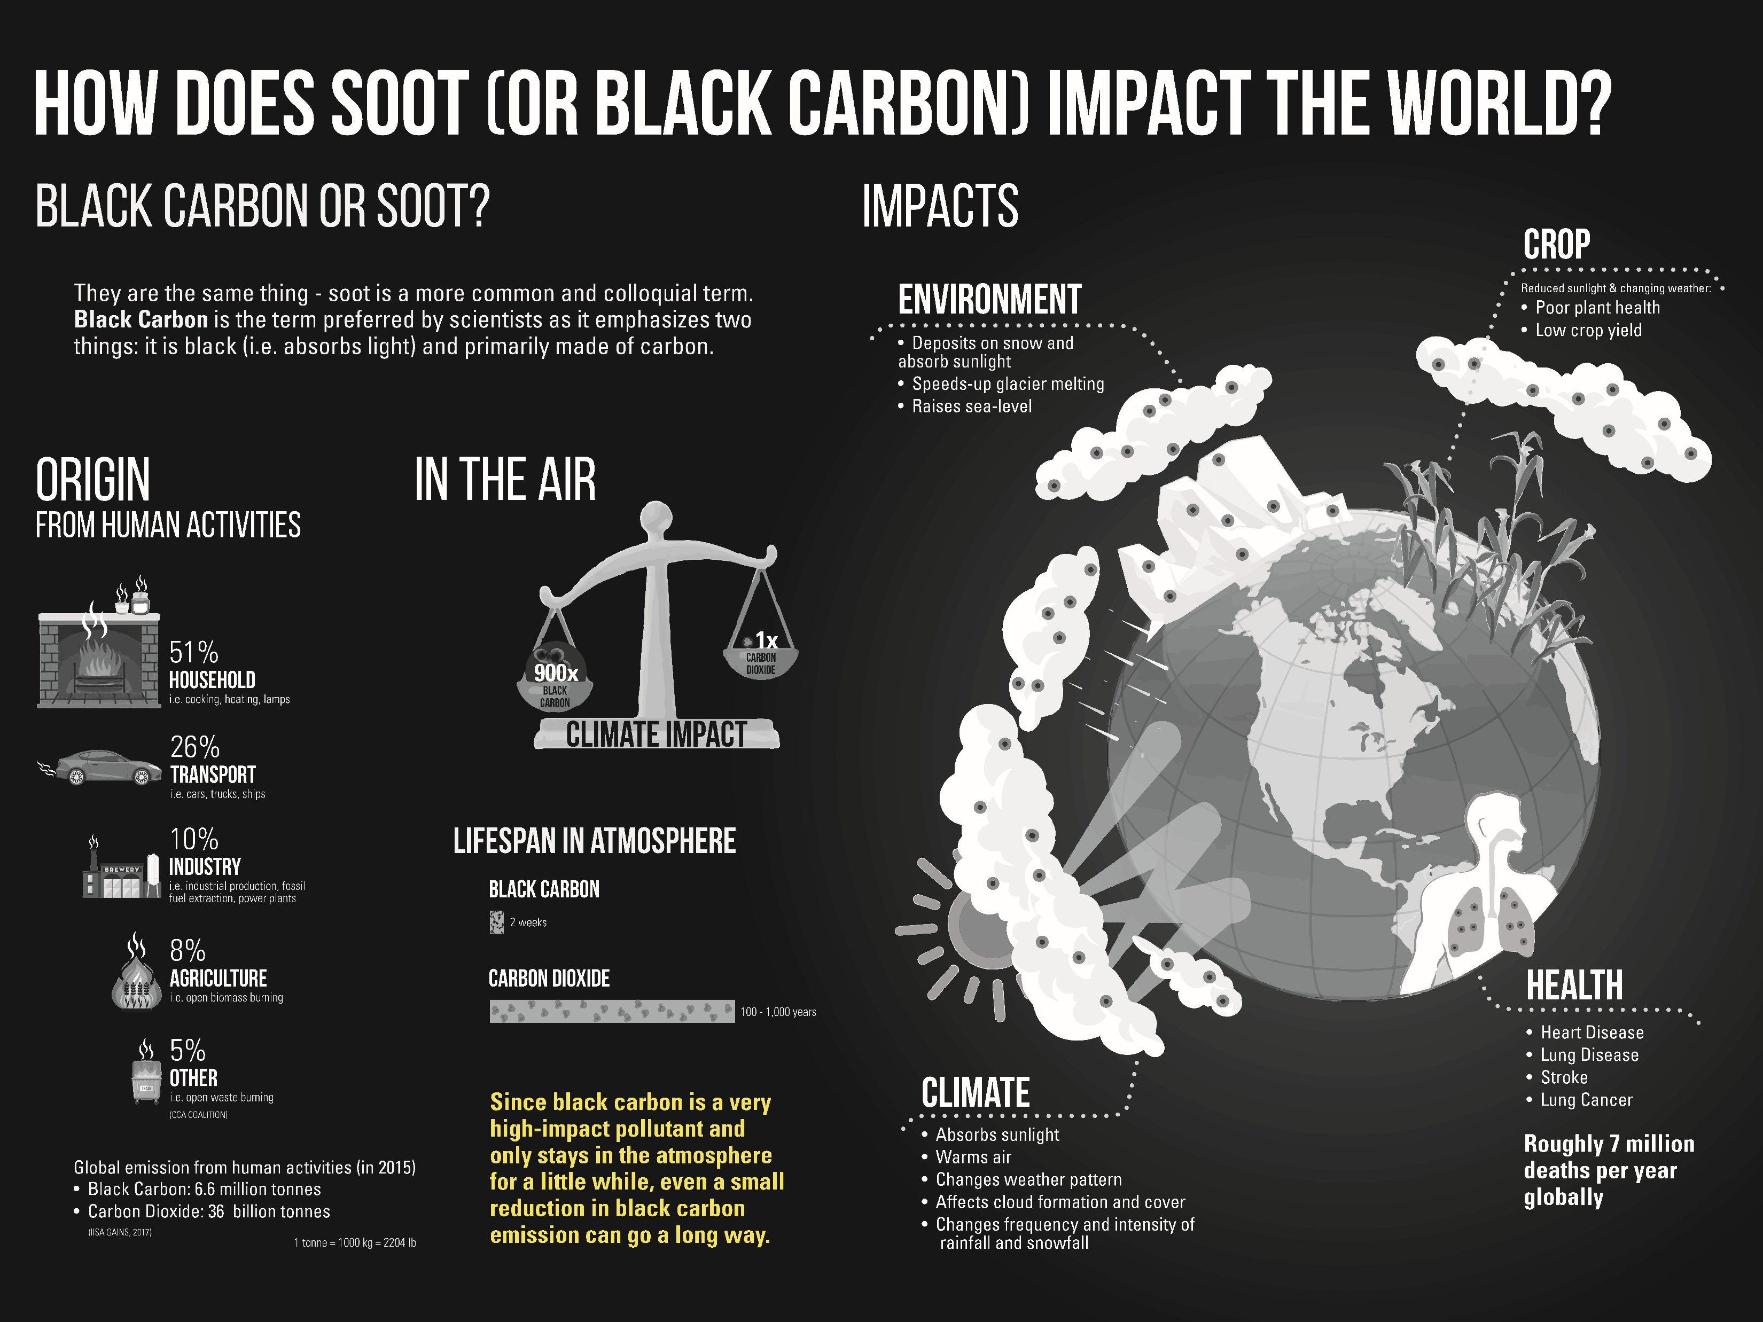
Soot has large impact on our lives

Slide 4
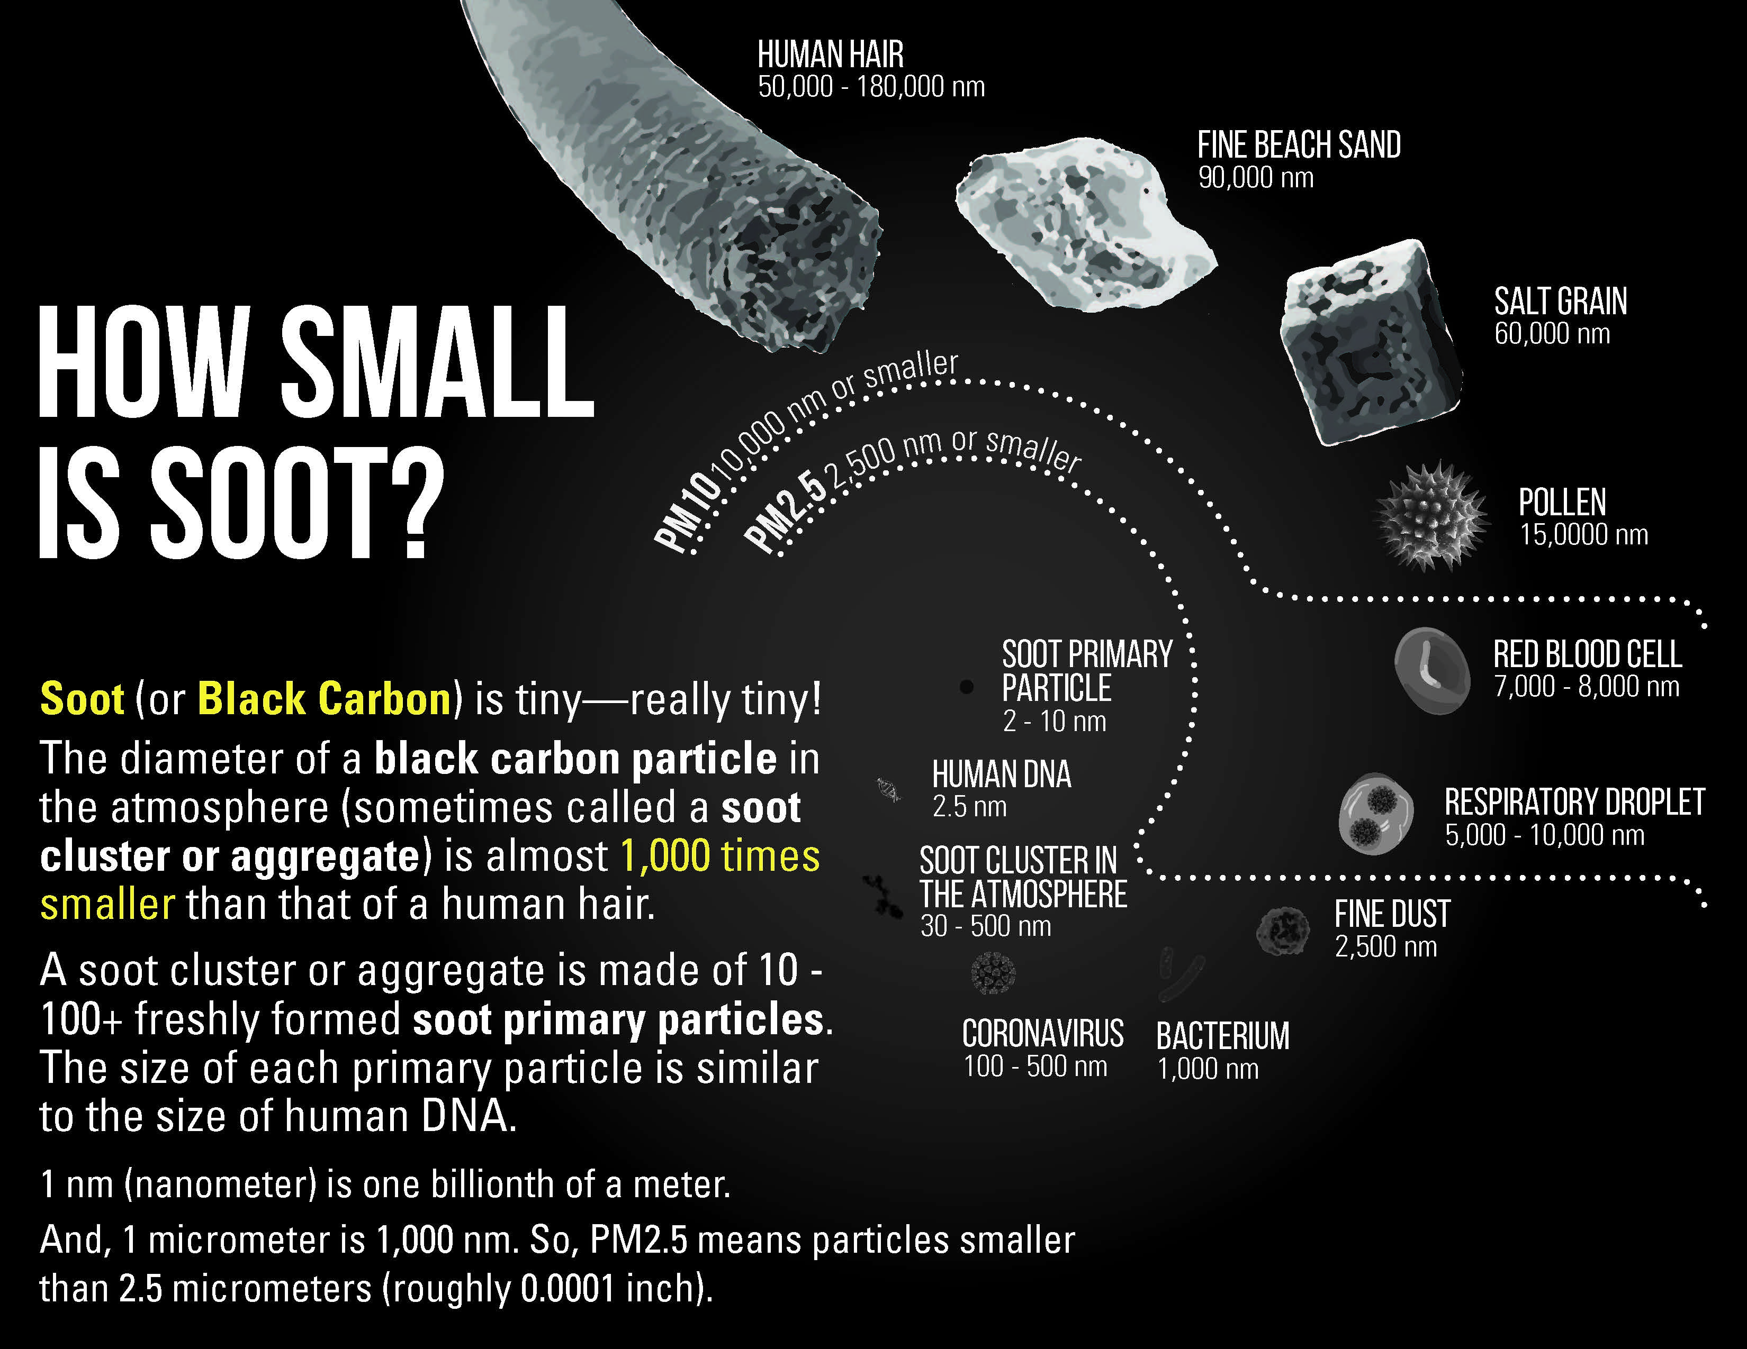
Soot is a major component of particulate matter or PM in the air
PM10: PM smaller than 10 micrometer
PM2.5: PM smaller than 2.5 micrometer
PM1: PM smaller than 1 micrometer

Slide 5

The Common Air Pollutants
1
2
3
4
Carbon Monoxide
Particulate Matter
Nitrogen Dioxide
Ozone
A poisonous gas produced by cars and other vehicles that can cause headaches and dizziness when inhaled.
A mixture of tiny particles that can be inhaled, including dust, dirt, soot, and smoke that comes from fires.
A gas from burning fossil fuels that can harm the respiratory system and weaken the immune system.
A gas that can be harmful to people with respiratory problems in high concentrations. It's formed by a reaction between sunlight and certain pollutants.

